Slide 1

Team: KV-MIND HACKERS
Autonomous satellite for planetary communication
KAAVIYA BHARATHI K
VIJITHA K
DUSHYANDHINI P
NAGALAKSHIMI
MYTHILI M
MONISHAA N

Slide 2
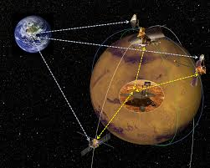
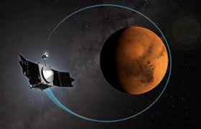
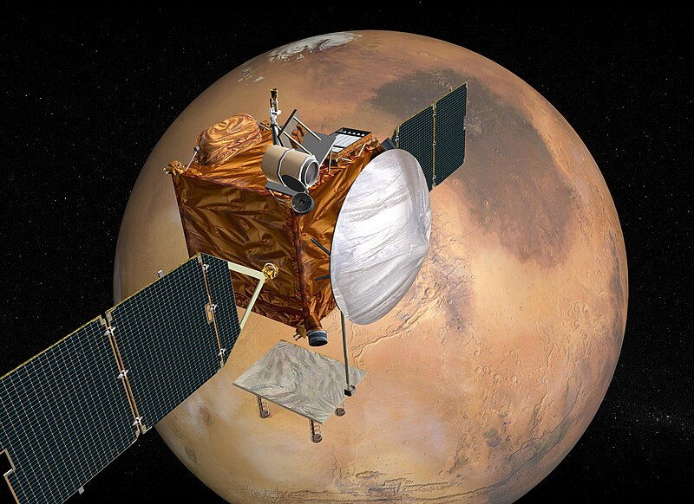
NASA’s MARS RELAY NETWORK
MARS RELAY NETWORK is a project of NASA on satellite communication relay.
Optimize communication efficiency by staying in orbit
CONTINUOUS
High-Bandwidth
communication

Slide 3
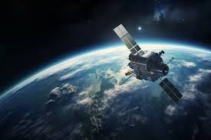
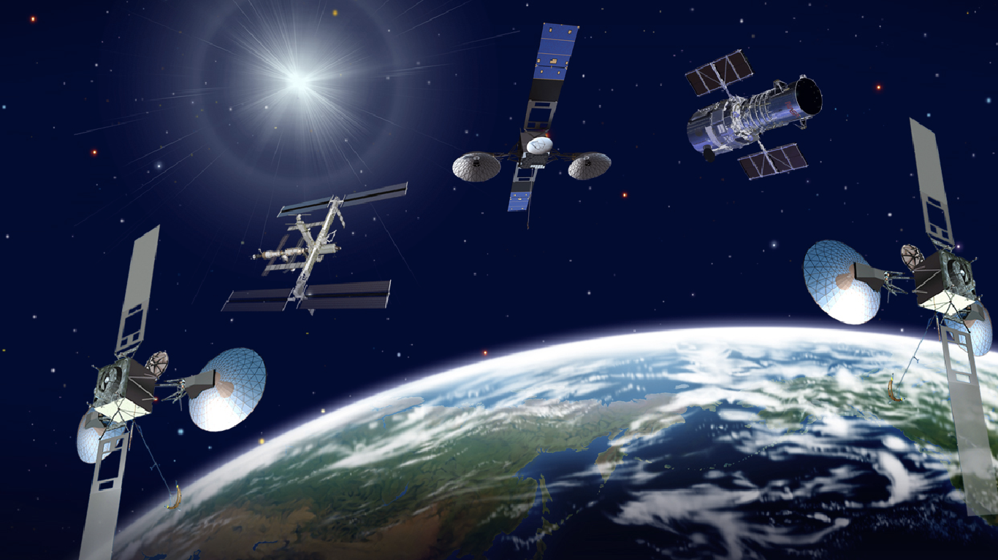
INTRO:
Perform its functions with minimal to no human intervention
PLANETARY COMMUNICATION:
The transmission of signals between planets and space stations.
Refer to EARTH DATA 2023/09/13 13:43:55

Slide 4
How does it works ?
Autonomous Navigation
It uses onboard sensors to determine and adjust its position and orbit.
Data Relay
It receives signals from planetary spacecraft, storing and retransmitting them to Earth during communication windows.
Power Management:
It regulates power use via solar panels and batteries, conserving energy in low-power modes.
AI & Algorithms
Machine learning is used to predict communication needs and manage network traffic.
Onboard Processing
The satellite processes and compresses data locally before transmission, reducing bandwidth requirements
Self-Maintenance
The satellite monitors its health and adjusts components like solar panels and antennas for optimal efficiency

Slide 5
How to does it help us ?
Ensuring Reliable Communication
Enhancing Scientific Research
Supporting Human Exploration
Collecting and Processing Data
Providing Emergency Communication
Coordinating Logistics
Building an Inter-planetary Network

Slide 6
Website
A. J. Vanelli-Coralli, C. Sacchi, and M. Angelone, "Autonomous satellite systems for planetary communication: Challenges and opportunities," IEEE Commun. Surv. Tutor., vol. 22, no. 2, pp. 3456-3478, 2020.
K. P. Valavanis, G. J. Kliot, and E. G. Clancy, "Autonomous satellite networks for interplanetary communication: A survey," IEEE Trans. Aerosp. Electron. Syst., vol. 27, no. 1, pp. 1412-1426, 2019
S. Dutta, M. B. Navathe, and T. Sheth, "Communication protocols for autonomous planetary satellites: Recent advancements," IEEE Commun. Lett., vol. 23, no. 5, pp. 1230-1235, 2019
H. L. Jones, R. T. Chang, and N. A. Adams, "Innovations in autonomous satellite communication for planetary exploration missions," IEEE Trans. Commun., vol. 26, no. 8, pp. 2103-2115, 2021.

Slide 7
Summary :
Autonomous satellite relays data between Earth and planetary missions.
Manages communication and adjusts orbit independently.
Improves efficiency and reduces communication delays.
Supports future exploration and human missions.
Uses AI, antennas, RTOS, C/C++, and Python for operations.

